Slide 2
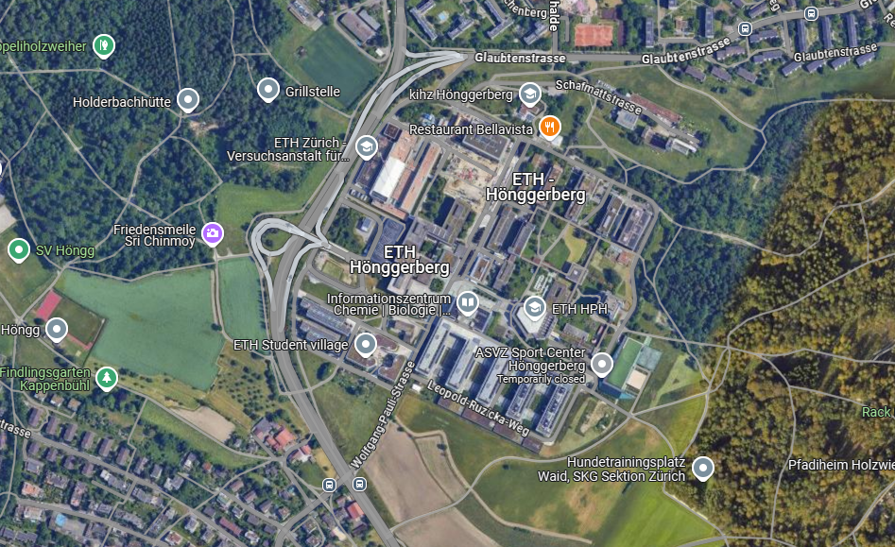


Hoenggerberg forest
Campus ETH Hoenggerberg
Kaeferberg forest
Student housing

Slide 3
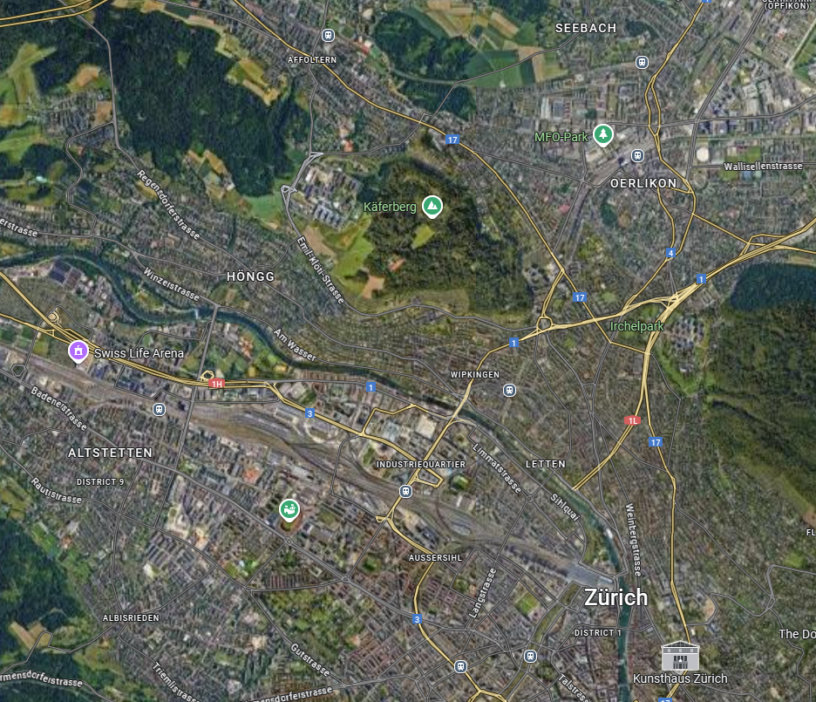
Hoenggerberg forest
Campus ETH Hoenggerberg
Kaeferberg forest

